Slide 1
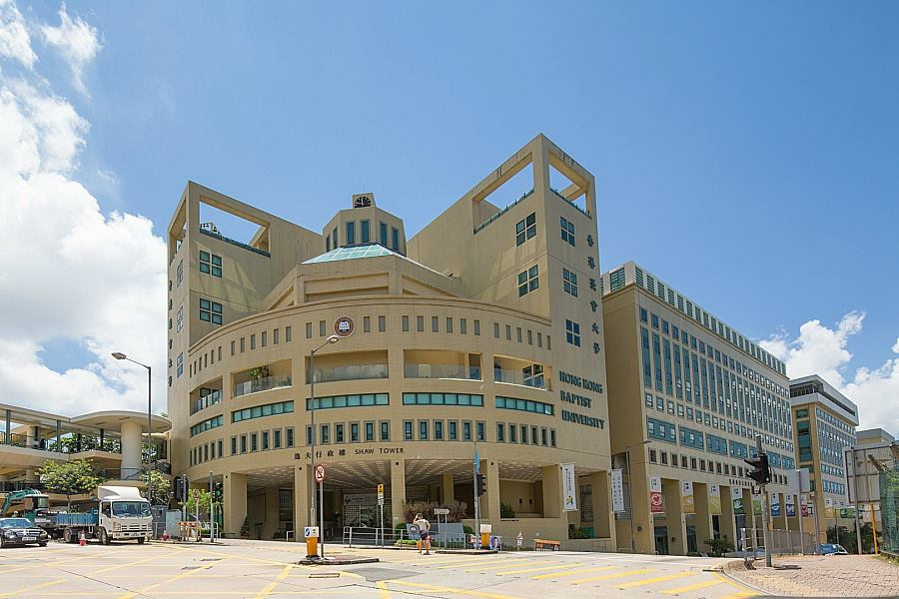
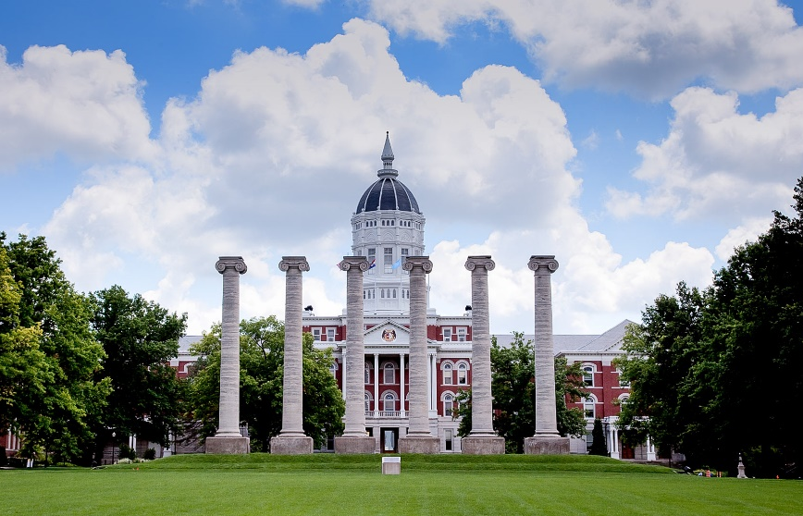
HKBU-MU Double Degree Programme This briefing is for 2021 intake students at HKBU
Bachelor of Communication conferred by Hong Kong Baptist University (HKBU)
Bachelor of Journalism conferred by The University of Missouri (MU)
Ms. Jenny Lam
Dr. Regina Chen
COMD Ref: HKBU-MU PPT_20211112 1223

Slide 2
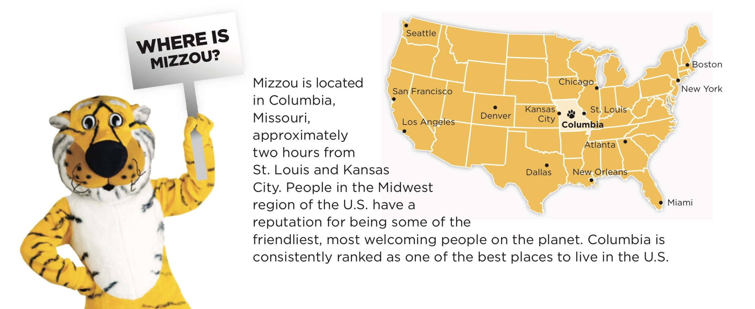
About MU
HKBU-MU Double Degree Programme
Ranking by U.S. News & World Report | 122
Ranking by Communication and Media Studies subject in QS Global University Ranking 2020 | 38

Slide 3
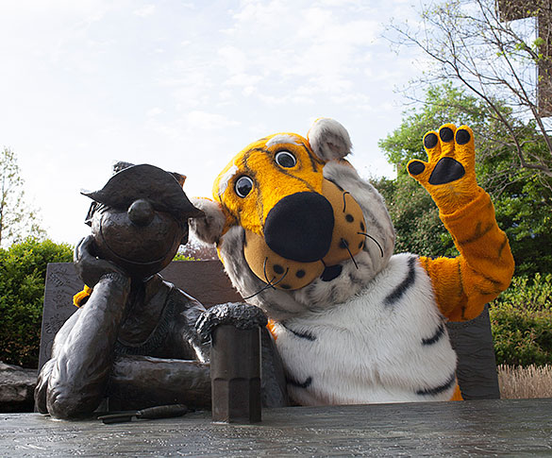
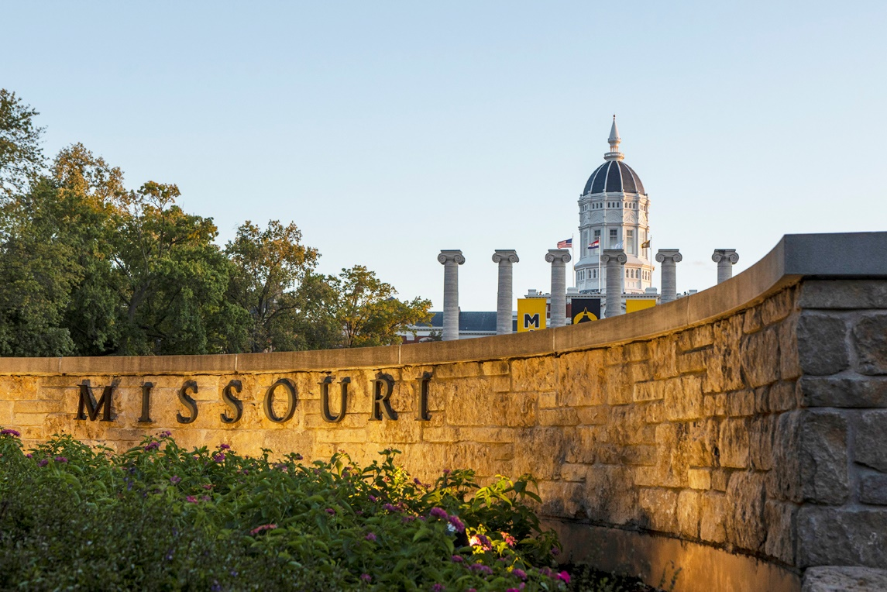
Why should students take a Double Degree Programme?
HKBU-MU Double Degree Programme
Get two world-class degrees in two world-class universities
Gain an international experience in one of the world’s most diverse and welcoming countries

Slide 4
Areas of Study
HKBU-MU Double Degree Programme
HKBU School of Communication and Film | MU School of Journalism
Bachelor of Communication (Honours) Journalism and Digital Media Major - International Journalism Concentration Public Relations and Advertising Major - Advertising and Branding Concentration - Organizational Communication Concentration - Public Relations Concentration | Bachelor of Journalism, with emphasis in: Convergence Journalism Magazine Journalism Photojournalism Print and Digital News Radio-Television Strategic Communication

Slide 5
Programme Duration
HKBU-MU Double Degree Programme
For Journalism and Digital Media – International Journalism students
4.5 years, full-time
2 years at HKBU + 2.5 years at MU
Year 1
Sem 1
(Sep 2021)
Year 1
Sem 2
(Jan 2022)
Year 2
Sem 1
(Sep 2022)
Year 2
Sem 2
(Jan 2023)
Year 3
Sem 1
(Aug 2023)
Year 3
Sem 2
(Jan 2024)
Year 4
Sem 1
(Aug 2024)
Year 4
Sem 2
(Jan 2025)
Year 5
Sem 1
(Aug 2025)
HKBU
HKBU
HKBU
HKBU
MU
MU
MU
MU
MU
For Public Relations and Advertising students
4 years, full-time
2 years at HKBU + 2 years at MU
Year 1
Sem 1
(Sep 2021)
Year 1
Sem 2
(Jan 2022)
Year 2
Sem 1
(Sep 2022)
Year 2
Sem 2
(Jan 2023)
Year 3
Sem 1
(Aug 2023)
Year 3
Sem 2
(Jan 2024)
Year 4
Sem 1
(Aug 2024)
Year 4
Sem 2
(Jan 2025)
HKBU
HKBU
HKBU
HKBU
MU
MU
MU
MU

Slide 6
HKBU-MU Double Degree Programme
Quota
A small number (2-4) of outstanding HKBU students
Academic & English Proficiency Requirements
Minimum cGPA requirement | 3.20 (out of 4.00)
English proficiency requirements | Overall score of 7.0 and at least 6.0 in each sub-band in IELTS, or Overall score of 100 in TOEFL, or Overall score of 120 in Duolingo with the total scores of 3 out of 4 sub-bands no less than 90

Slide 7
Tuition Fee and Financial Support
HKBU-MU Double Degree Programme
HKBU local students will pay HKBU standard tuition fees, i.e., HK$42,100 per academic year.
HKBU non-local students will pay MU tuition fees out of their own pockets (USD24,812 (~HK$193,534) for 2021-22).
The School will provide one-off travelling subsidies (economy fare) to each enrolled student of this programme.
Cost of Studying (per year)
Tuition fees | HKBU local students: HK$42,100 HKBU non-local students: USD24,812 (~HK$193,534) for 2021-22
Living expenses | USD16,178 (~HK$126,188)
Health insurance | USD2,277 (~HK$17,760)
Total estimated cost per year | HKBU local students: ~HK$186,049 HKBU non-local students: ~HK$337,483
Note: Amounts are subject to change.
(https://international.missouri.edu/wp-content/uploads/sites/4/2021/06/Estimated-expenses_21-22.pdf)

Slide 8
Important Dates
HKBU-MU Double Degree Programme
30 Jan 2022
Application closed
Late Mar 2022
Interview
Late Jun 2022
Result announcement
Early Mar 2022
Interview notification sent to shortlisted applicants
Mid Jun 2022
Release of Sem 2’s GPA
For Applications and Enquiries
Ms. Sherine Tam, School of Communication and Film, HKBU
Tel: 3411 7492
Email: sherine@hkbu.edu.hk

Slide 9
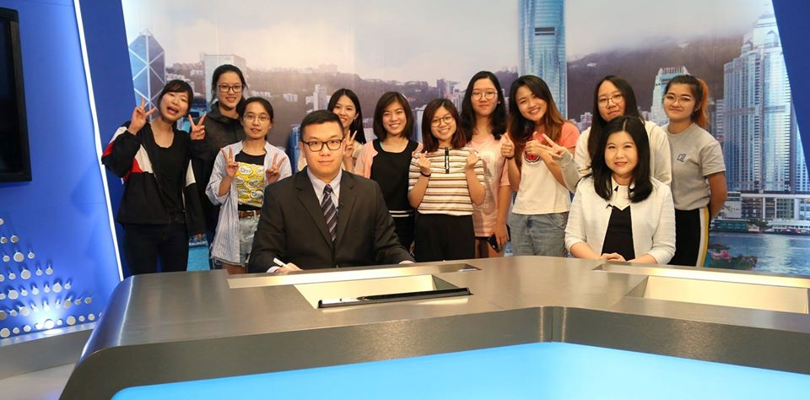
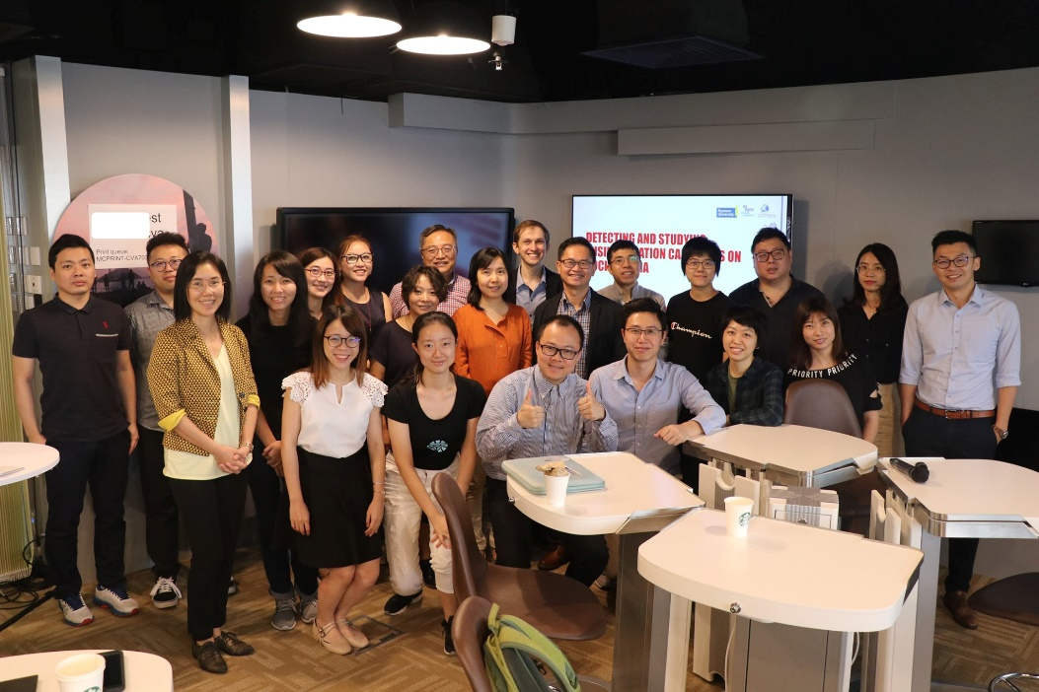
For JOUR-IJ Students

Slide 10
Study Plan at HKBU
For JOUR-IJ Students
JOUR-IJ students will have to complete 79 units (out of 128) at HKBU in Year 1 and Year 2.
The remaining units required for graduation will be fulfilled through transfer of units or course exemption by completing equivalent courses at MU.
 | Units
Major Requirement (Including School Core and Major Core Courses) | 33
Free Electives | 15
University Core & GE | 31
Total | 79
Study Plan at MU
After being admitted to MU, JOUR-IJ students will be assigned with an academic advisor by MU School of Journalism to create a tailor-made study schedule that fit their needs.

Slide 11
Study Schedules in Year 1
For JOUR-IJ Students
SEMESTER 1 | Units
COMM1015 Studies in Communication, Journalism and Film | 3
JOUR2085 English News Reporting and Writing | 3
University Chinese | 3
University English I | 3
GE – Quantitative Reasoning | 3
Free Elective | 3
Total | 18
SEMESTER 2 | Units
JOUR2077 Chinese News Reporting and Writing | 3
JOUR2087 Multimedia and Multiplatform Journalism or JOUR2117 Broadcast Reporting and Production | 3
3rd School Core Course | 3
University English II | 3
GE - Values and the Meaning of Life | 3
Free Elective | 3
Total | 18

Slide 12
Study Schedules in Year 2
For JOUR-IJ Students
SEMESTER 1 | Units
COMM2035 Communication, Ethics and Law | 3
JOUR2096 Advanced News and Feature Writing (English) | 3
JOUR2116 Finance and Economics for Journalists | 3
JOUR4007 Research Methods in Communication | 3
GE – Interdisciplinary Thematic Course | 3
GE – History and Civilization | 3
Free Elective | 3
Total | 21
SEMESTER 2 | Units
JOUR2076 Data Journalism | 3
JOUR3137 Communication Theory and Film | 3
Healthy Lifestyle | 2
The Art of Persuasion | 2
GE - Interdisciplinary Thematic Course | 3
GE Capstone | 3
Free Elective | 3
Total | 19

Slide 13
Things to Note
For JOUR-IJ Students
For the 2021 intake cohorts, students who wish to enrol in HKBU-MU Double Degree Programme will have to take one extra Free Elective (3 units) in Summer Programme 2022.
Free Electives of HKBU are equivalent to the General Education Courses of MU. Students are suggested to take Science or Chinese Medicine courses at HKBU.
To meet the graduation requirements of both universities, JOUR-IJ students are expected to study 2 years at HKBU and 2.5 years at MU.

Slide 14
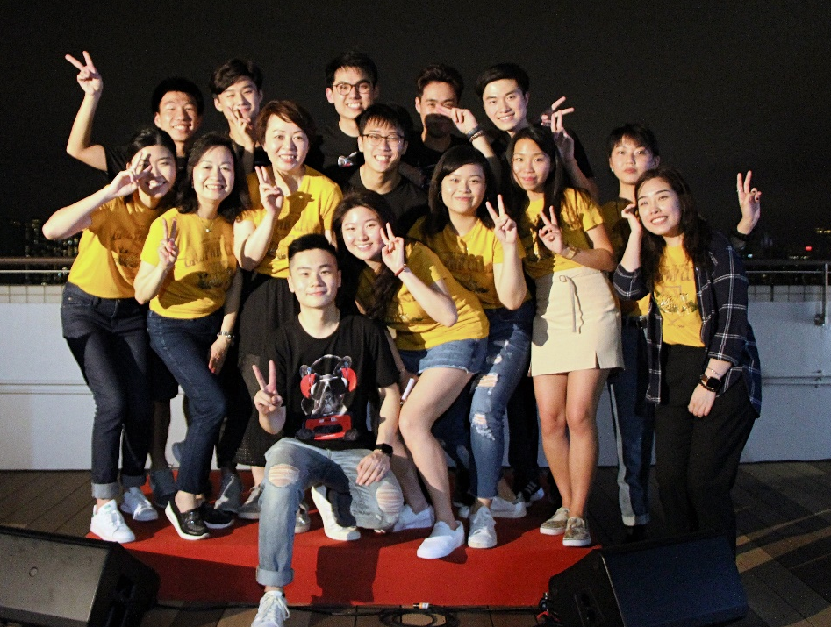
For PRA Students

Slide 15
Study Plan at HKBU
For PRA Students
PRA students will have to complete 76 units (out of 128) at HKBU in Year 1 and Year 2.
The remaining units required for graduation will be fulfilled through transfer of units or course exemption by completing equivalent courses at MU.
 | Units
Major Requirement (Including School Core and Major Core Courses) | AB/PR: 27-48 ORGC: 30-45
Free Electives | AB/PR: Up to 27 ORGC: Up to 24
University Core & GE | 25
Total | 76
Study Plan at MU
After being admitted to MU, PRA students will be assigned with an academic advisor by MU School of Journalism to create a tailor-made study schedule that fit their needs.

Slide 16
Study Schedules in Year 1
For PRA Students
SEMESTER 1 | Units
COMM1015 Studies of Communication, Journalism and Film | 3
PRAO2046 Internal Communication and Employee Engagement | 3
University Chinese | 3
University English I | 3
GE - History and Civilization | 3
GE – Quantitative Reasoning | 3
Total | 18
SEMESTER 2 | Units
PRAO2007 Principles and Practices of Advertising | 3
PRAO2015 Principles and Practices of Public Relations | 3
3rd School Core Course | 3
The Art of Persuasion | 2
GE - Values and the Meaning of Life | 3
Free Electives / AB Concentration Electives | 6
Total | 20

Slide 17
Study Schedules in Year 2
For PRA Students
(AB & PR)
SEMESTER 1 | Units
COMM2006 Communication Theory | 3
COMM2035 Communication, Ethics and Law | 3
GE - Interdisciplinary Thematic Courses | 2
Free Electives / AB/PR Concentration Electives | 9
Healthy Lifestyle | 0-2
Total | 18-20
SEMESTER 2 | Units
COMM2007 Communication Research Method | 3
AB: PRAO3005 Content Creation in Advertising PR: PRAO3035 Public Relations Writing | 3
Free Electives / AB/PR Concentration Electives | 12
Healthy Lifestyle | 0-2
Total | 18-20

Slide 18
Study Schedules in Year 2
For PRA Students
(ORGC)
SEMESTER 1 | Units
COMM2006 Communication Theory | 3
COMM2035 Communication, Ethics and Law | 3
GE - Interdisciplinary Thematic Courses | 2
Free Electives / ORGC Required Electives / ORGC Concentration Electives | 9
Healthy Lifestyle | 0-2
Total | 18-20
SEMESTER 2 | Units
COMM2007 Communication Research Method | 3
PRAO2047 Advanced Media Design for Corporate Communication | 3
PRAO3066 Writing for Professional Communication | 3
Free Electives / ORGC Required Electives / ORGC Concentration Electives | 9
Healthy Lifestyle | 0-2
Total | 18-20

Slide 19
Things to Note
For PRA Students
For the 2021 intake cohorts, students who wish to enrol in HKBU-MU Double Degree Programme will have to take one extra Free Elective Course (3 units) in Summer Programme 2022.
Free Electives of HKBU are equivalent to the General Education Courses of MU. Students are suggested to take Science or Chinese Medicine courses at HKBU.

Slide 20
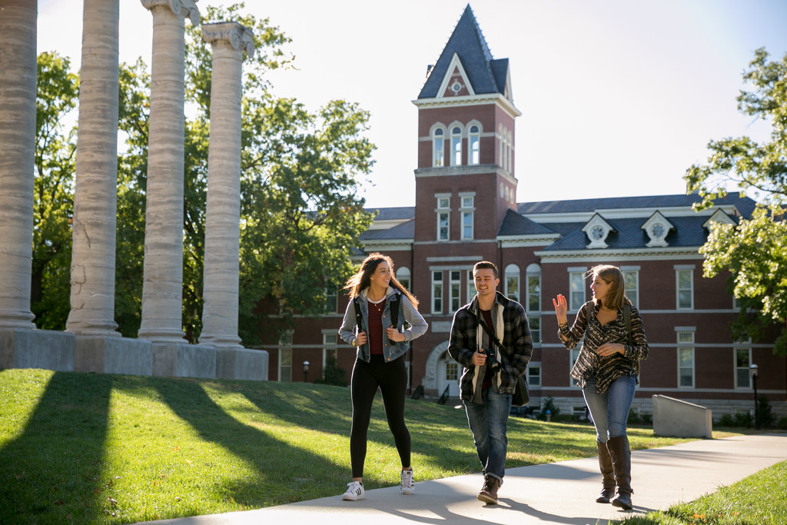
Thank you!

